Slide 1



EduVision_DV
Global Higher Education Insights

Slide 2




Technology Stack: The Higher Education Analytics Stack
Python: The Foundation of Data Analytics
Numpy: The Power of Numerical Computing
Pandas: The Art of Data Manipulation
Tableau: The Power of Interactive Visualization
Python powers data collection, data cleaning, and analytical workflows, making complex data processing efficient and flexible.
NumPy enables fast numerical operations and efficient array processing, supporting mathematical computations and data analysis.
Pandas simplifies data cleaning, transformation, and analysis through powerful DataFrames and flexible data-handling tools.
Tableau transforms complex datasets into interactive dashboards, making higher-education insights easier to explore and understand.

Slide 3

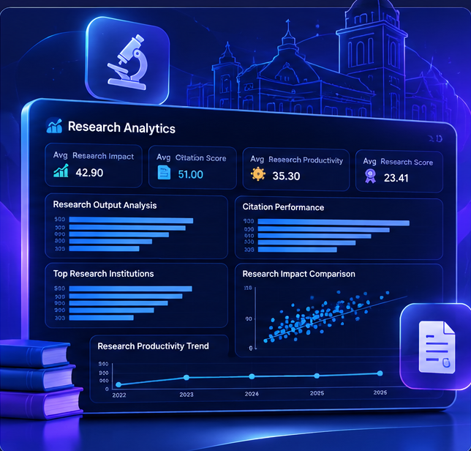
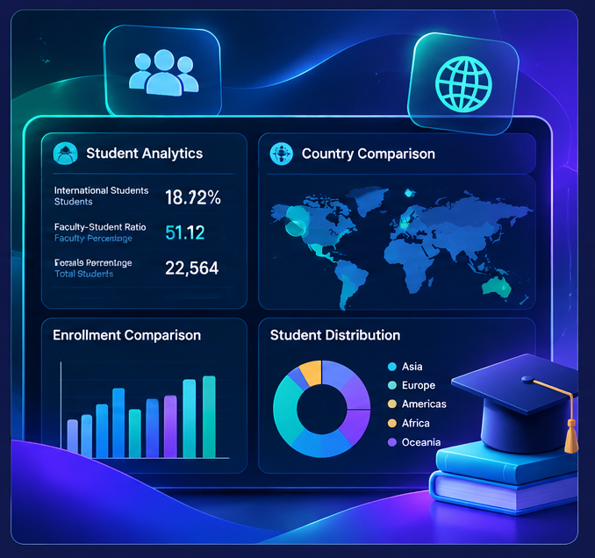
Core Features of EduVision_DV Analytics Platform
Comprehensive University Insights
Research Performance Analysis
Student & Country Analytics
Explore global university rankings, academic performance, and country-wise distribution through interactive visualizations that make institutional comparisons easier.
Analyze research impact, citation scores, and institutional productivity with data-driven charts that reveal research trends and compare academic contributions.
Understand student diversity, enrollment patterns, and international education trends while comparing educational performance across countries and regions.

Slide 4
Challenges in Higher Education Analytics
1
2
Fragmented Data Sources
Inconsistent Data Matching
University rankings and education datasets come from different sources, making it difficult to combine information and maintain consistency across institutions.
University rankings and education datasets come from different sources, making it difficult to combine information and maintain consistency across institutions.
3
4
Complex Performance Evaluation
Limited Interactive Insights
Static reports make it harder to explore trends, compare countries, and identify meaningful patterns. An interactive dashboard helps simplify these analyses.
Evaluating academic reputation, research impact, student diversity, and global rankings requires multiple indicators that can be difficult to interpret together.

Slide 5
System Architecture Overview
The system architecture of EduVision_DV is designed to support structured data processing, reliable KPI calculations, and interactive higher education analytics.
Key components include:
  Data Collection: Integrates university ranking datasets from QS and Times Higher Education (THE) to create a unified data foundation..
  Data Preprocessing: Cleans, standardizes, and matches university records using common identifiers to improve data consistency.
  KPI Engineering: Generates key performance indicators, including Global Ranking Score, Research Impact Score, and Research Productivity Index.
  Data Modeling: Organizes information into interconnected dimension and fact tables to support efficient analysis.
  Interactive Visualization: Uses Tableau to deliver four connected dashboards with filters, parameter actions, and navigation controls for exploring university, research, student, and country-level performance.

Slide 6
Challenges and Solutions in EduVision_DV
1
2
Data Integration Challenges
Data Quality & Missing Values
Combining university ranking datasets from different sources presented inconsistencies in university names, formats, and ranking indicators.
Solution: Implemented data cleaning, standardization, and university matching techniques to create a unified dataset.
Differences in source datasets and missing academic indicators made accurate comparisons challenging.
Solution: Applied data validation and preprocessing techniques while preserving missing values to maintain data integrity.
3
4
KPI Calculation & Metric Validation
Interactive Dashboard Integration
Defining meaningful performance indicators and ensuring consistent calculations across datasets required careful validation.
Solution: Developed six key performance indicators, including Global Ranking Score, Research Impact Score, and Research Productivity Index, and validated their calculations.
Connecting four dashboards while maintaining consistent filters, navigation, and university-level comparisons was a key implementation challenge.
Solution: Integrated interactive filters, parameter controls, navigation buttons, and dashboard actions to enable seamless exploration across University Overview, Research Analytics, Student Analytics, and Country Comparison.

Slide 7
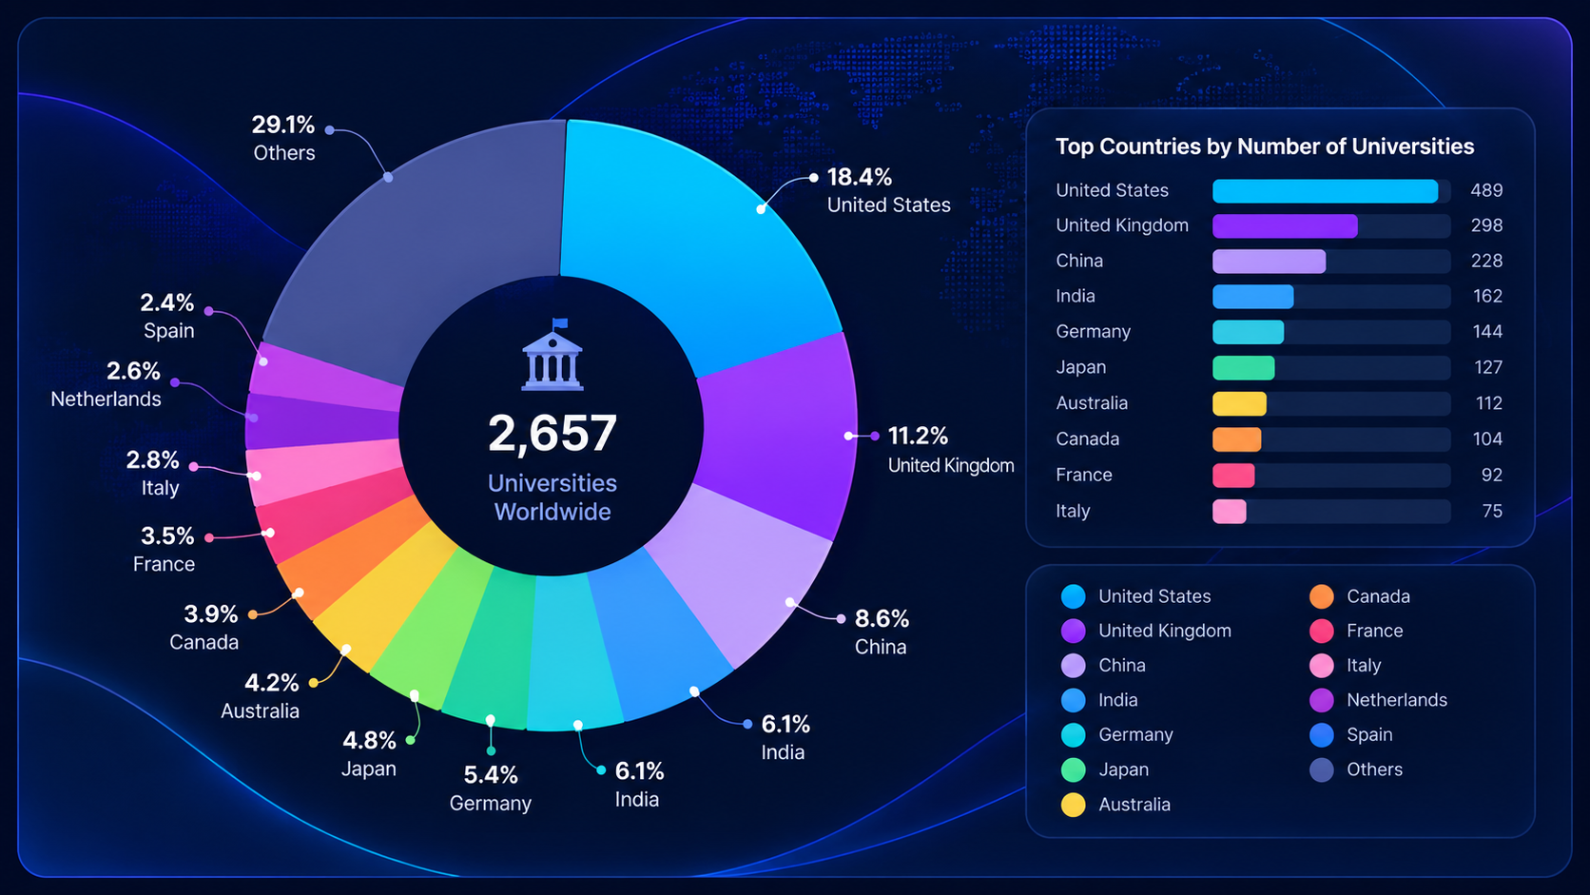
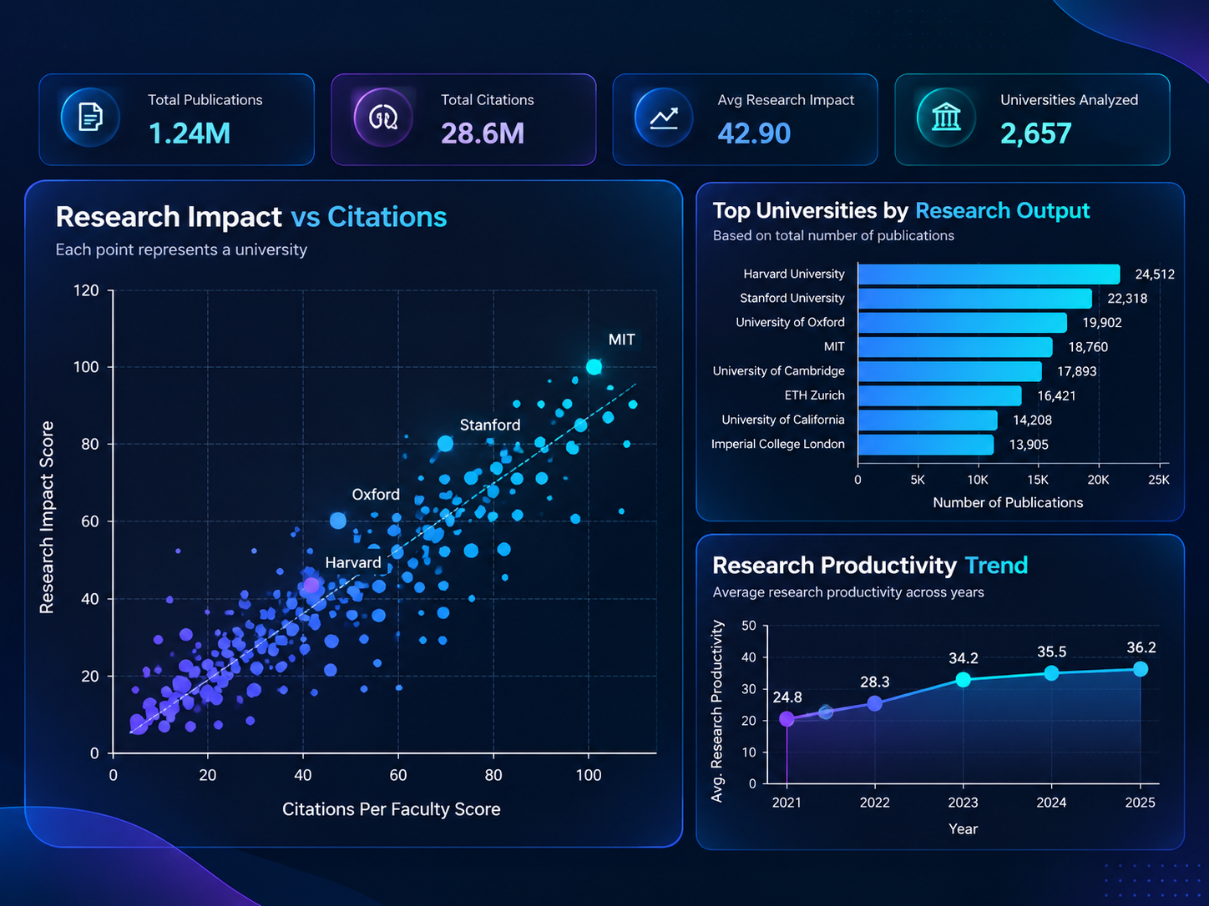
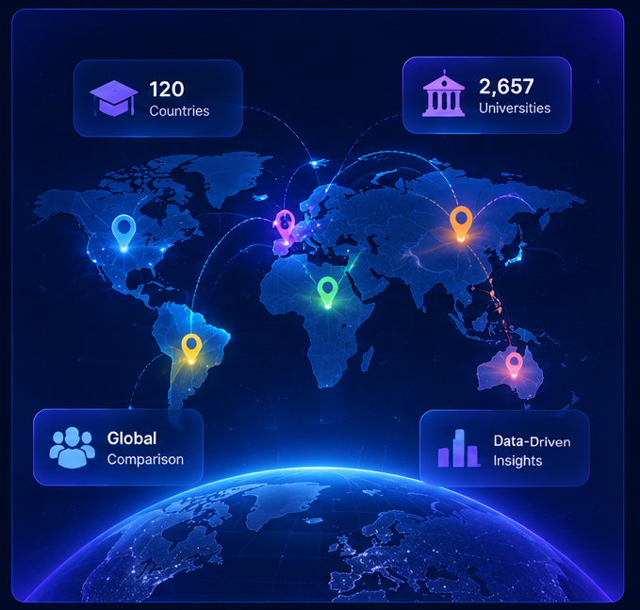
Measurable Outcomes and Positive Impact
Comprehensive University Insights
Data Driven Research Evaluation
Interactive Global Comparison
Explore 2,657 universities across 120 countries through interactive rankings and distribution analysis.
Compare research impact, citations, and productivity to identify leading institutions.
Analyze student diversity, regional trends, and country performance using connected dashboards.

Slide 8
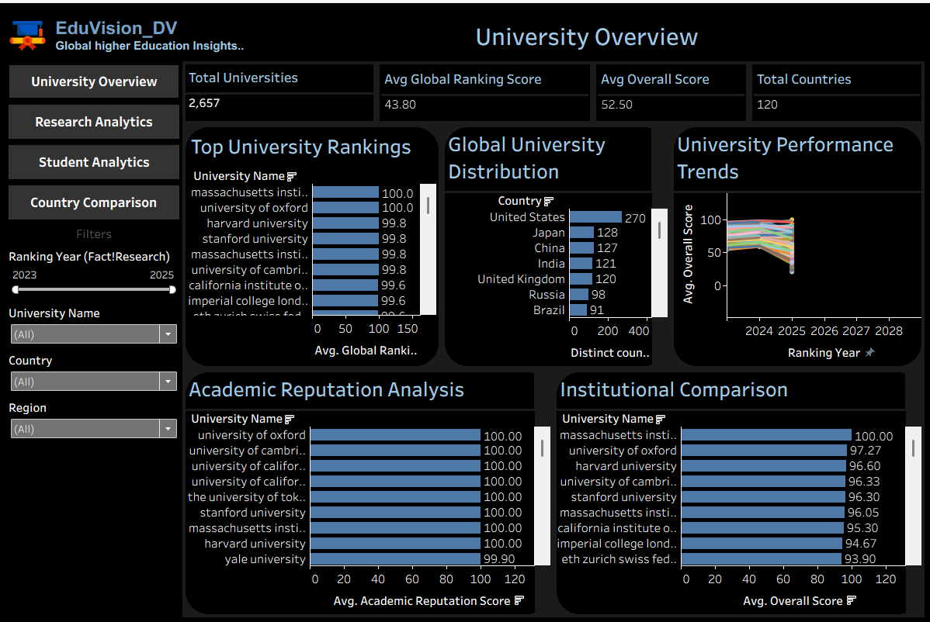
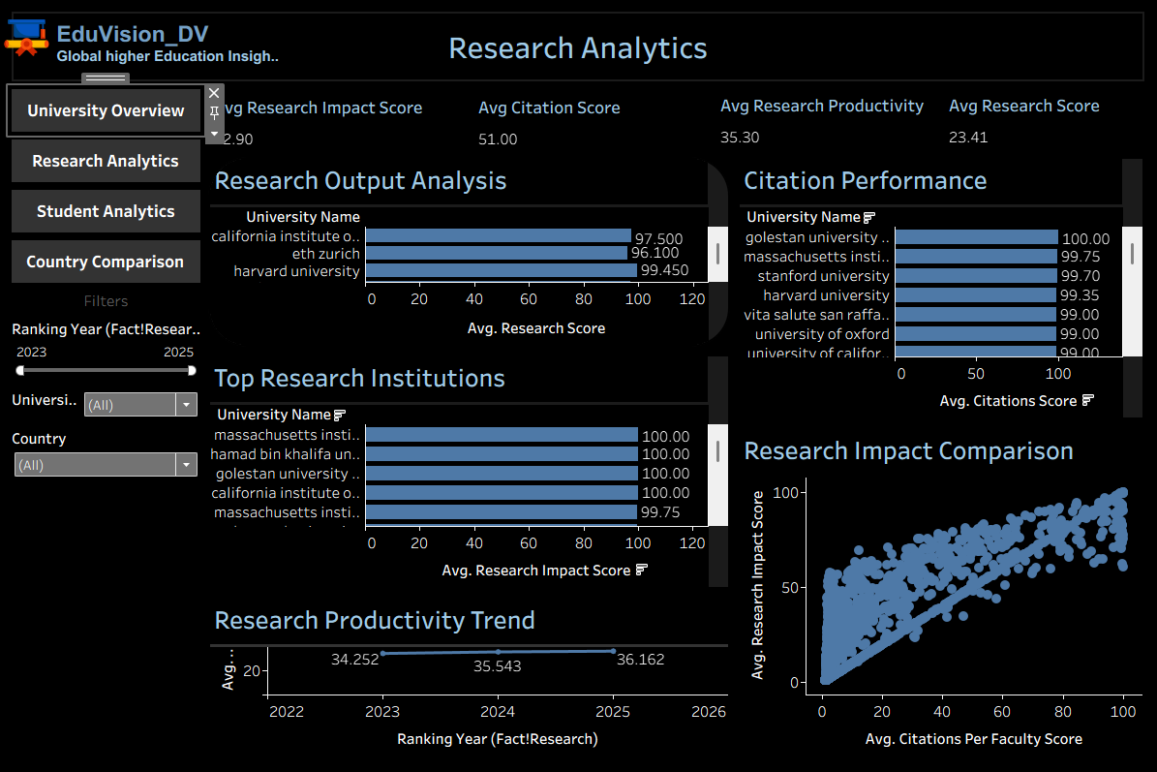
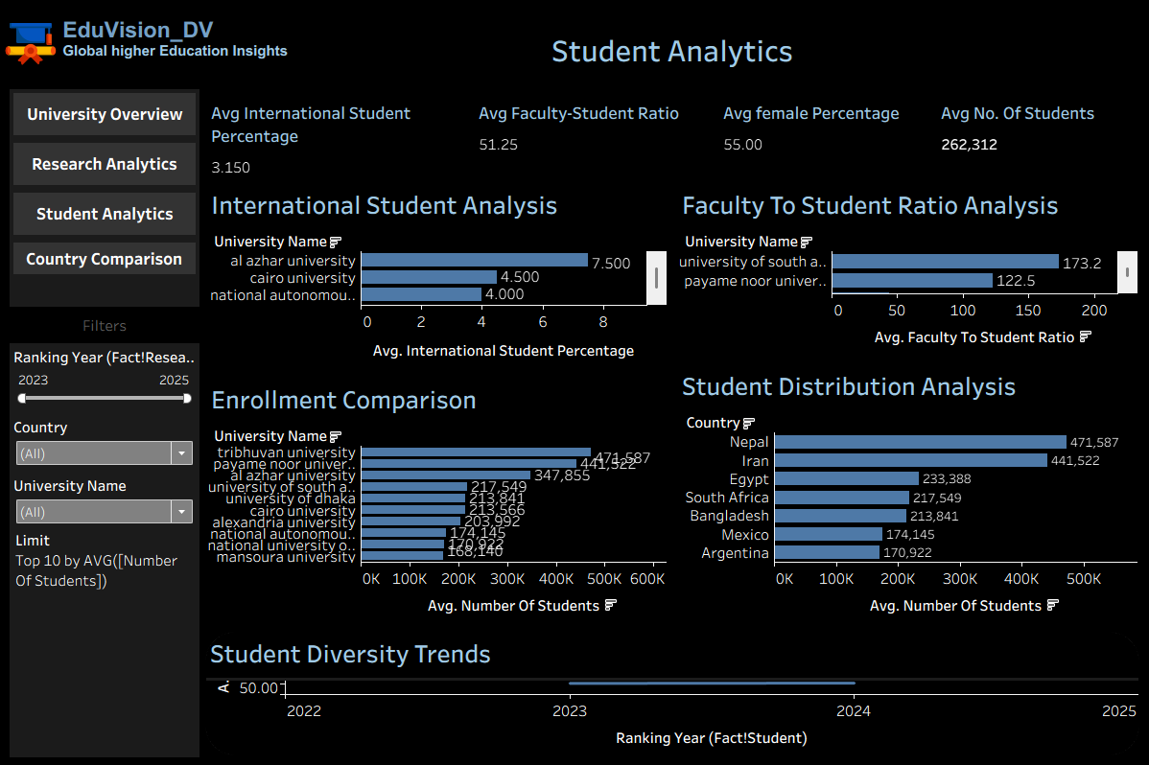
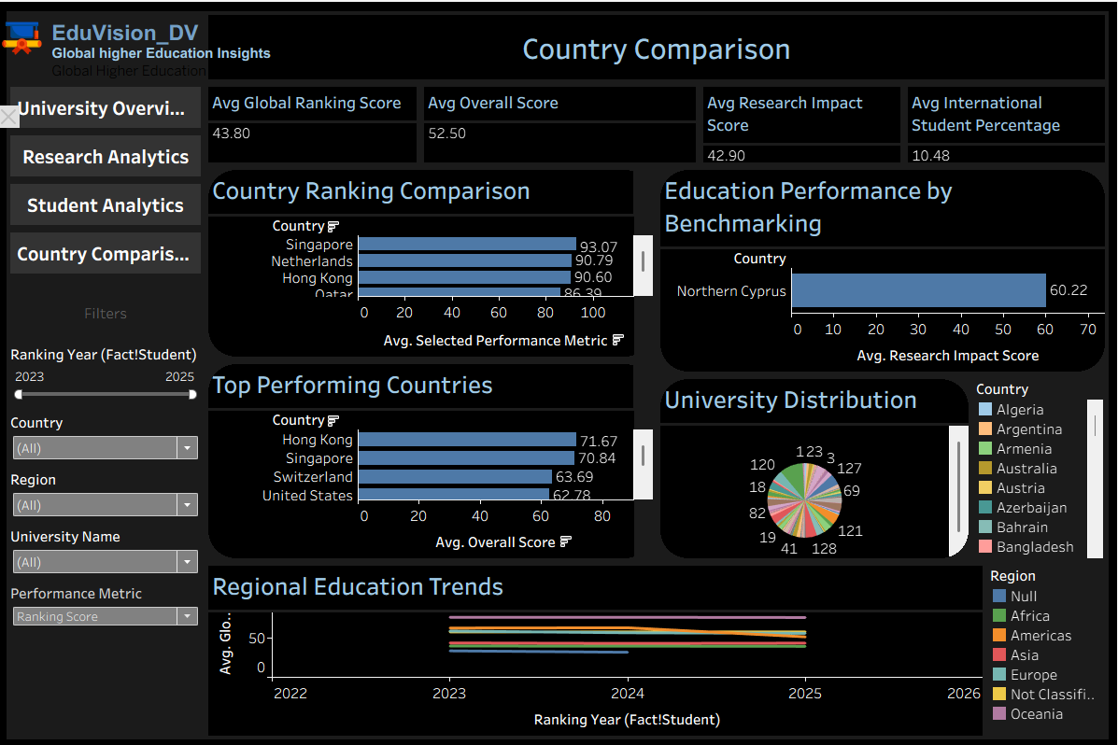
One Platform. Four Powerful Dashboards
Transforming global higher education data into actionable insights through interactive visualizations, performance analysis, and data-driven comparisons.
Explore. Analyze. Compare. Discover.

Slide 9

Dashboard Exploration
Explore global university rankings, research performance, student analytics, and country comparisons through four integrated dashboards.
Real-Time Exploration: Apply dynamic filters to uncover insights.
Data-Driven Decisions: Compare universities and education systems.
Unified Analytics: Navigate seamlessly across dashboards.

Slide 10



Future Enhancements for EduVision_DV
AI Powered Predictive Analytics
Real Time Data Integration
Advanced Comparative Insights
  Predict future university performance and ranking trends.
  Identify emerging research and education patterns.
  Generate data-driven insights for decision-making..
  Integrate updated university ranking datasets.
  Automate data collection and KPI calculations.
  Keep dashboards current with the latest available data.
  Enable deeper comparisons across universities and countries.
  Add interactive regional and global benchmarking.
  Expand visual analytics for research and student performance.

Slide 11
Project By
Sweta Mondal
Solo Developer | EduVision_DV
From Data Collection to Interactive Insights

Slide 12
Presentation Video...
https://drive.google.com/drive/folders/1qdUX4mZIYnqYw2uLk9LXyxibQahyiJgE?usp=drive_link

Slide 13
Q n A

Slide 14

Thank You

